Slide 1
Lecture 1-3
CSE233: OBJECT ORIENTED PROGRAMMING

Slide 2
Outline
Introduction of C++ Programming
Differences between Procedural and Object-Oriented Programming
Features of Input/Output Streams
Reading and Writing Data
Class and Object

Slide 3
Concepts and Basics of C++ Programming :
C++, as we all know is an extension to C language and was developed by Bjarne stroustrup at bell labs.
C++ is a general-purpose programming language and widely used nowadays for competitive programming. It has imperative, object-oriented and generic programming features. C++ runs on lots of platform like Windows, Linux, Unix, Mac, etc.

Slide 4
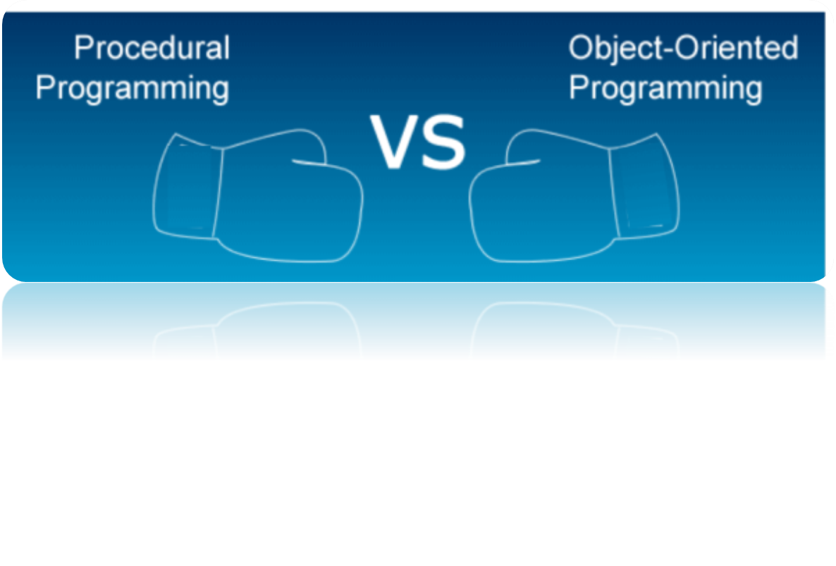
However, to become proficient in the C ++ programming language, one must first understand the fundamental differences between procedural and object-oriented programming paradigms.

Slide 5
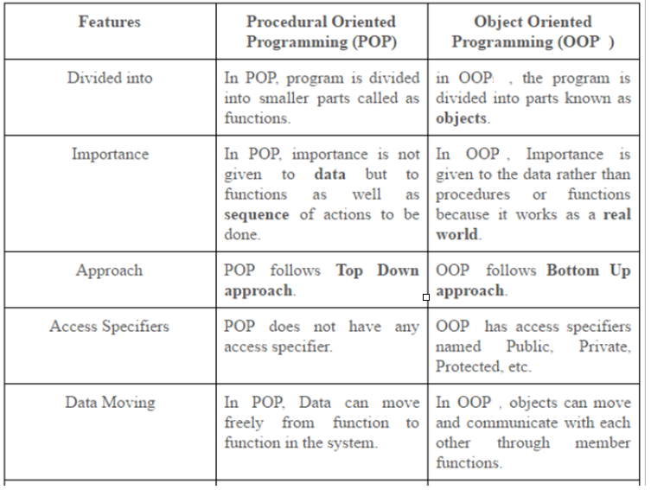

Slide 6
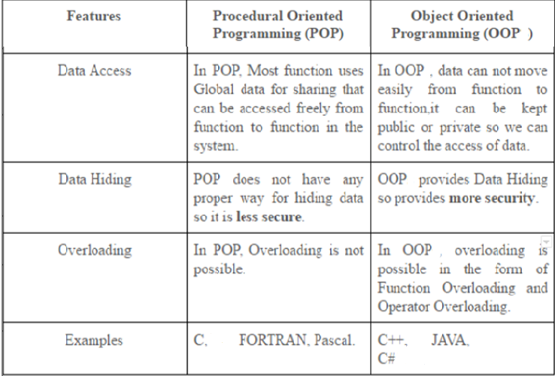

Slide 7
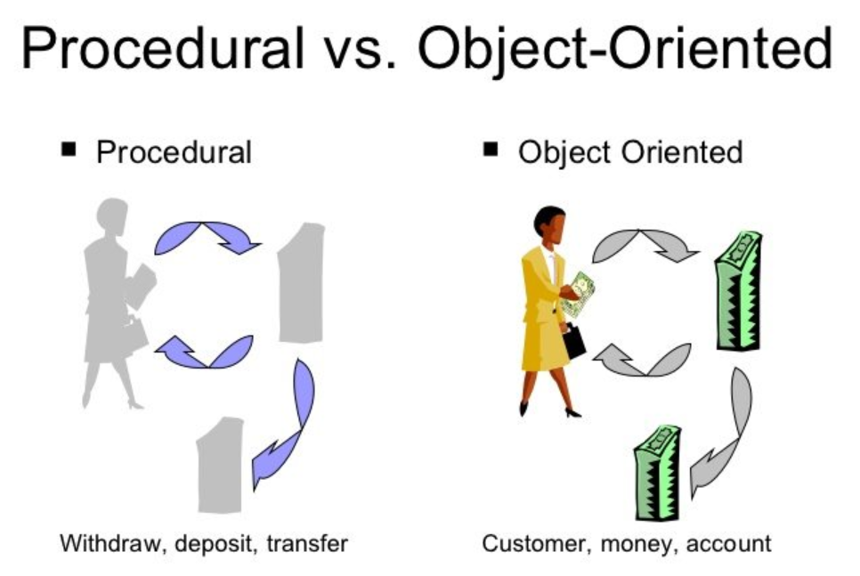

Slide 8
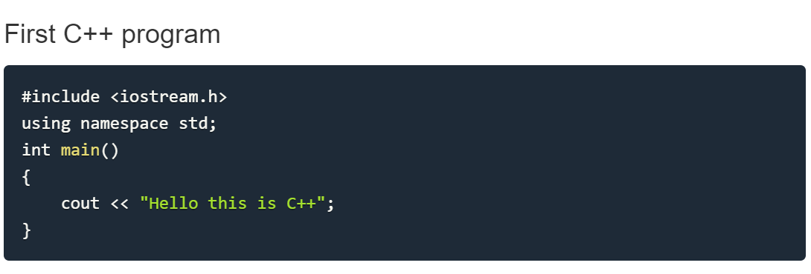
Features of Input/Output Streams
Here we will discuss one simple and basic C++ program to print "Hello this is C++" and its structure in parts with details and uses.

Slide 9
Header files are included at the beginning just like in C program. Here iostream is a header file which provides us with input & output streams. Header files contained predeclared function libraries, which can be used by users for their ease.
Using namespace std, Consider a situation, when we have two persons with the same name, ABC, in the same class. Whenever we need to differentiate them definitely we would have to use some additional information along with their name, like second name (PQR,STU..), rollno etc.
Same situation can arise in your C++ applications. For example, you might be writing some code that has a function called abc() and there is another library available which is also having same function abc(). Now the compiler has no way of knowing which version of abc() function you are referring to within your code.
A namespace is designed to overcome this difficulty and is used as additional information to differentiate similar functions, classes, variables etc. with the same name available in different libraries. Using namespace, you can define the context in which names are defined. In essence, a namespace defines a scope.

Slide 10
Therefore, Namespace collects identifiers used for class, object and variables. NameSpace can be used by two ways in a program, either by the use of using statement at the beginning, like we did in above mentioned program or by using name of namespace as prefix before the identifier with scope resolution (::) operator.
Examples:
Using namespace std;
cout<<“A”;
std::cout << "A";

Slide 11
cout <<, is used to print anything on screen, same as printf in C language. cin and cout are same as scanf and printf, only difference is that you do not need to mention format specifiers like, %d for int etc, in cout & cin.
Example:
int a=10;
printf(“a= %d”,a); (In C programming)
cout<<“a=“<<a; (In C++ programming)
Cout/cin will discuss later

Slide 12
The file iostream includes
The streams of includes and outputs of program effect.
The declarations of the basic standard input-output library.
both a and b
none of these

Slide 13
The file iostream includes
The streams of includes and outputs of program effect.
The declarations of the basic standard input-output library.
both a and b
none of these

Slide 14
Reading and Writing Data
Two operators are introduced in c++ i.e. cout and cin.
cout is a predefined object and represents the standard output stream and this output stream represents the screen.
eg. cout<<“Hello”;
cout will display this string as such on screen.
<< is called insertion operator.
if “a’ is variable then cout can be used to display the contents of “a”.
cout<< a;

Slide 15
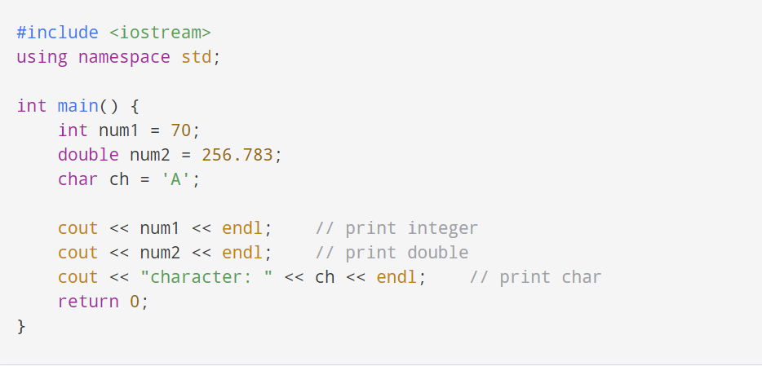
To print the numbers and character variables:
Notes:
The endl manipulator is used to insert a new line. That's why each output is displayed in a new line.
The << operator can be used more than once if we want to print different variables, strings and so on in a single statement. For example:
cout << "character: " << ch << endl;

Slide 16
cin is a predefined object and represents the standard input stream and this input stream is used to read the data or take value from user.
eg: int a,b;
cin>>a>>b;
>> is called extraction operator.
In C++, cin takes formatted input from standard input devices such as the keyboard.

Slide 17
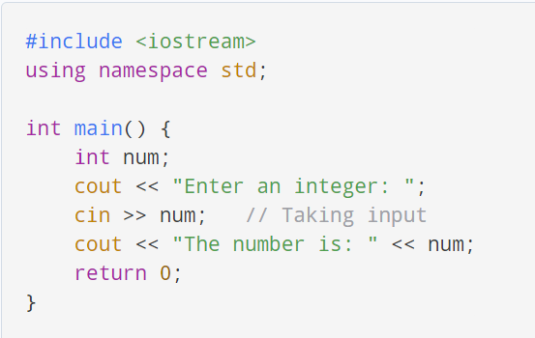
Example: Enter and Display Integer Value
Note: If we don't include the using namespace std; statement, we need to use std::cin instead of cin .
Taking Multiple Inputs: cin>>a>>b>>c;

Slide 18
The operator used with cout is called:
a. Insertion operator
b. Extraction operator
c. Get operator
d. Comparison operator

Slide 19
The operator used with cout is called:
a. Insertion operator
b. Extraction operator
c. Get operator
d. Comparison operator

Slide 20
The operator used with cin is called:
a. Insertion operator
b. Extraction operator
c. Get operator
d. Comparison operator

Slide 21
The operator used with cin is called:
a. Insertion operator
b. Extraction operator
c. Get operator
d. Comparison operator

Slide 22
In CPP, cin and cout are the predefined stream __________ .
a. Operator
b. Functions
c. Objects
d. Data types

Slide 23
In CPP, cin and cout are the predefined stream __________ .
a. Operator
b. Functions
c. Objects
d. Data types

Slide 24
Classes in CPP are________ .
a. derived data types
b. User defined data types
c. built-in data types
d. All of these

Slide 25
Classes in CPP are________ .
a. derived data types
b. User defined data types
c. built-in data types
d. All of these

Slide 26
Classes in CPP are________ .
a. derived data types
b. User defined data types
c. built-in data types
d. All of these

Slide 27
C++ practicing examples
Program to Find Largest Number Among Three Numbers
Program to Calculate Sum of Natural Numbers
Program to Check Whether a Number is Prime or Not
Program to Display Fibonacci Series

Slide 28
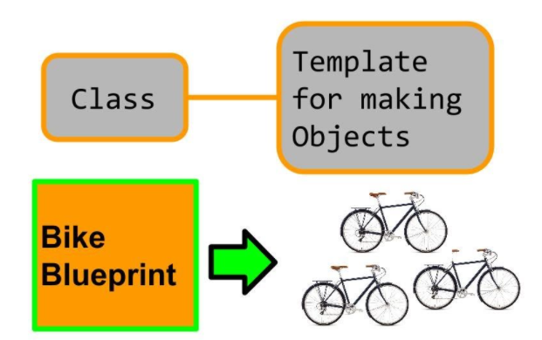
Class and objects
In C++, rather than creating separate variables and functions, we can also wrap these related data and functions in a single place (by creating objects). This programming paradigm is known as object-oriented programming.
But before we can create objects and use them in C++, we first need to learn about classes.

Slide 29
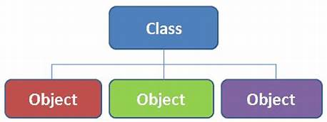
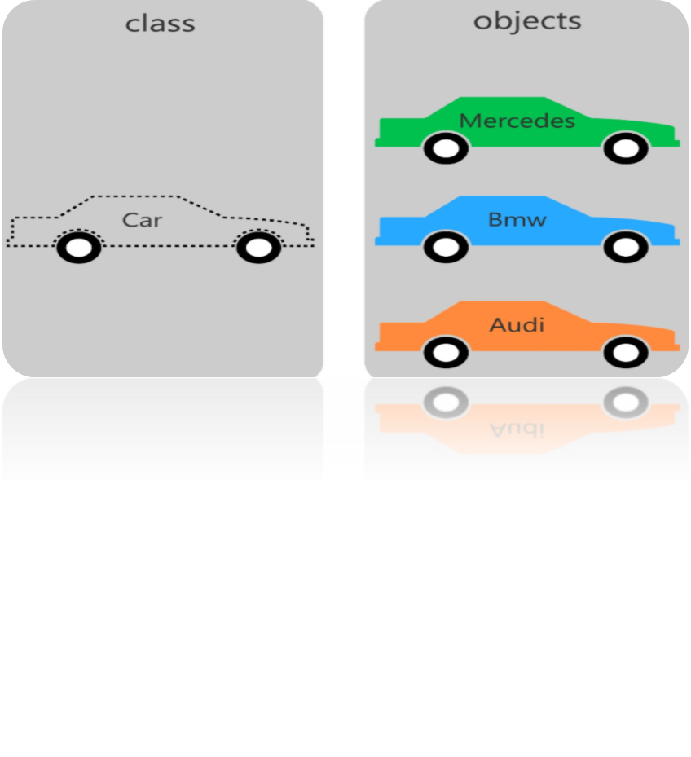

Slide 30
Class
A class is a blueprint for the object.
We can think of a class as a sketch (prototype) of a house. It contains all the details about the floors, doors, windows, etc. Based on these descriptions we build the house. House is the object.
Create a Class
A class is defined in C++ using keyword
class followed by the name of the class.
The body of the class is defined inside
the curly brackets and terminated by a “;” at the end.
class className
{
// some data
// some functions
};

Slide 31
Class: A class in C++ is the building block, that leads to Object-Oriented programming. It is a user-defined data type, which holds its own data members and member functions, which can be accessed and used by creating an instance of that class..
For Example: Consider the Class of Cars. There may be many cars with different names and brand but all of them will share some common properties like all of them will have 4 wheels, Speed Limit, cost etc.

Slide 32
What does your class can hold?
A. data
B. functions
C. both a & b
D. none of the mentioned

Slide 33
What does your class can hold?
A. data
B. functions
C. both a & b
D. none of the mentioned

Slide 34
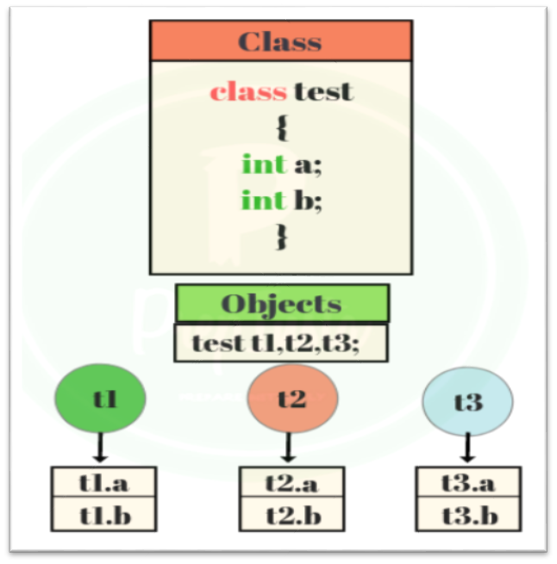
An Object is an instance of a Class. When a class is defined, no memory is allocated but when it is instantiated (i.e. an object is created) memory is allocated.
When a class is defined, only the specification for the object is defined; no memory or storage is allocated. To use the data and access functions defined in the class, you need to create objects.
Syntax:
ClassName ObjectName;

Slide 35
Accessing a Data Member
Accessing a data member depends solely on the access control of that data member. If its public, then the data member can be easily accessed using the direct member access (.) operator with the object of that class.
class A
{
public:
int x;
Void func();
}obj1;
main()
{
A obj2;
obj1.x=10;
obj2.x=20;
obj1.func();
---
}
Access Specifier : will discuss in the next slide
1st Method to declare object
2nd Method to declare object
Obj_name.Var1
Obj_name.function()
Accessing data members using obj

Slide 36
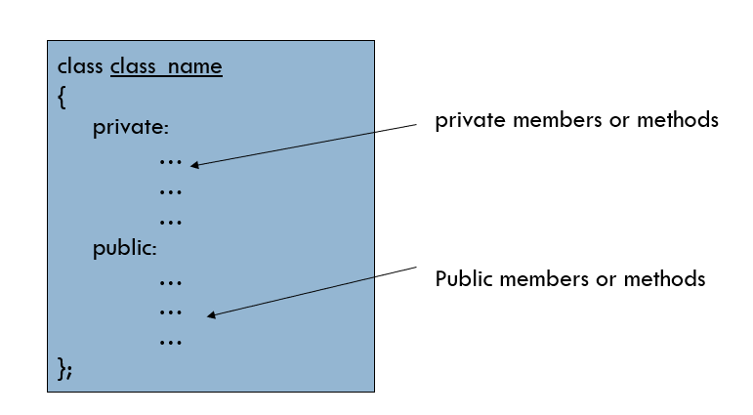
C++ supports three access specifiers:
  public
  private
  protected
The public access specifier allows a class to subject its member variables and member functions to other functions and objects.
The private access specifier allows a class to hide its member variables and member functions from other class objects and functions. (Default Access Specifier)
The protected access specifier allows a class to hide its member variables and member functions from other class objects and functions just like private access specifier - is used while implementing inheritance.
will discuss it after MTT

Slide 37
Area of a circle
// C++ program to demonstrate public
// access modifier
#include <iostream>
using namespace std;
// class definition
class Circle {
public:
double radius;
double compute_area()
{
return 3.14 * radius * radius;
}
};
int main()
{
Circle obj;
// accessing public data member outside class
obj.radius = 5.5;
cout << "Radius is: " << obj.radius << "\n";
cout << "Area is: " << obj.compute_area();
return 0;
}
// C++ program to demonstrate private
// access modifier
#include <iostream>
using namespace std;
class Circle {
private:
double radius;
public:
void compute_area(double r)
{
radius = r;
double area = 3.14 * radius * radius;
cout << "Radius is: " << radius << endl;
cout << "Area is: " << area;
}
};
int main()
{
Circle obj;
obj.radius = 5.5;
// Error trying to access private data member
// directly outside the class
obj.compute_area(1.5);
return 0;
}

Slide 38
The default access level assigned to members of a class is ___________
a)Private
b)Public
c)Protected
d)Needs to be assigned

Slide 39
The default access level assigned to members of a class is ___________
a)Private
b)Public
c)Protected
d)Needs to be assigned

Slide 40
We cannot use __________ members outside the class
a. Public
b. private
c. Protected
d. Local

Slide 41
We cannot use __________ members outside the class
a. Public
b. private
c. Protected
d. Local

Slide 42
PUBLIC | PRIVATE
All the class members declared under public will be available to everyone. | The class members declared as private can be accessed only by the functions inside the class.
The data members and member functions declared public can be accessed by other classes too. | Only the member functions or the friend functions are allowed to access the private data members of a class.
The public members of a class can be accessed from anywhere in the program using the direct member access operator (.) with the object of that class. | They are not allowed to be accessed directly by any object or function outside the class.
will discuss it later

Slide 43
Find output:
class Circle {
int radius;
float compute_area()
{
radius=1;
return 3.14 * radius * radius;
}
};
int main()
{
Circle obj;
cout << "Area is: " << obj.compute_area();
return 0;
}
a: 3.140000
b: 3.14
c: no output
d: error

Slide 44
Find output:
class Circle {
int radius;
float compute_area()
{
radius=1;
return 3.14 * radius * radius;
}
};
int main()
{
Circle obj;
cout << "Area is: " << obj.compute_area();
return 0;
}
a: 3.140000
b: 3.14
c: no output
d: error
Note: Pvt. member can’t access outside the class

Slide 45
Methods definition
The member function of the class can be defined in two different ways:
Inside the class definition:- The member functions are simple defined inside the class only i.e the body of the function resides inside the range of class only.
2) Outside the class definition: by using scope resolution operator, which specifies that the scope of the function is restricted to the class class_name.
Syntax:- class_name:: function_name

Slide 46
Inside the class definition
Eg: class abc
{
private:
int rollno;
char name[20];
public:
void getdata()
{
cout<<“name=“;
cin>>name;
cout<<“rollno=“;
cin>>rollno;
}
void display()
{
cout<<“name=“<<name;
cout<<“rollno=“<<rollno;
}
};

Slide 47
Outside the class definition
Example:
class abc
{
private:
int rollno;
char name[20];
public:
void getdata();
void display();
};
void abc :: getdata()
{
cout<<“name=“;
cin>>name;
cout<<“rollno=“;
cin>>rollno;
}
void abc :: display()
{
cout<<“name and rollno=“;
cout<<name<<rollno;
}

Slide 48
C++ practicing examples
Class to represent the details of a student
Class to represent the details of two students
Class to represent the ‘n’ student details.

Slide 49
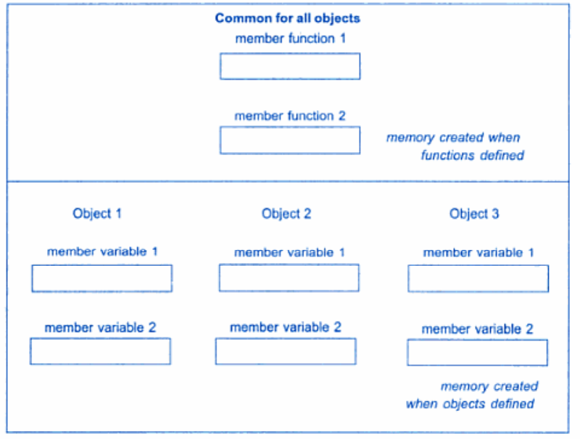
More points
Size of the empty class in C++ is 1 byte(Reason: Unique address identification for objects)
Memory allocation for objects:

Slide 50
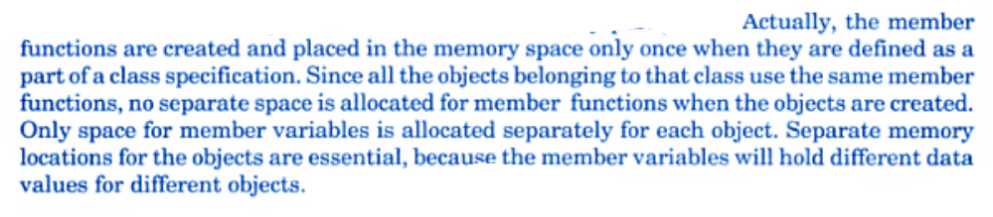
Memory allocation for objects

Slide 51



